Slide 1
C# Bootcamp
{ Module 5: Arrays, Variable Parameter List }
June 16, 2022

Slide 2
Module Objectives
Learn array basics
Declare arrays and perform compile-time initialization of array elements
Access elements of an array
Become familiar with methods of the Array class
Write methods that use arrays as parameters
Write classes that include arrays as members and instantiate user-defined array objects
Use the ArrayList class to create dynamic lists
Learn about the predefined methods of the string class
Be introduced to the other collection classes

Slide 3
Array Basics

Slide 4
Array Basics
Array Basics
Data structure that may contain any number of variables
Variables must be of same type
Single identifier given to entire structure
Individual variables are called elements
Elements accessed through an index
Index also called subscript
Elements are sometimes referred to as indexed or subscripted variables

Slide 5
Array Basics
Array Basics
Array class includes methods and properties
Methods for creating, manipulating, searching, and sorting arrays
Create an array in the same way you instantiate an object of a user-defined class
Use the new operator
Specify number of individual elements

Slide 6
Array Declaration
Array Basics
You create an array in much the same way you instantiate an object of a user-defined class—by using the new keyword at the time of declaration.
You can also specify during declaration the number of individual elements for the array.
The format for creating an array is as follows:
Type can be any predefined types like int or string, or a class that you create in C#
Integral value is the number of elements
Length or size of the array
Can be a constant literal, a variable, or an expression that produces an integral value

Slide 7
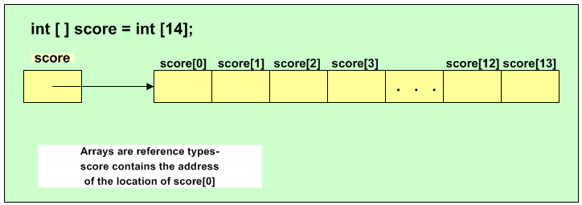
Array Declaration
Array Basics
It must represent an integer, a whole number, or an expression that maps to a
whole number.
To create an array to hold the 14 homework scores discussed previously, you could write:

Slide 8
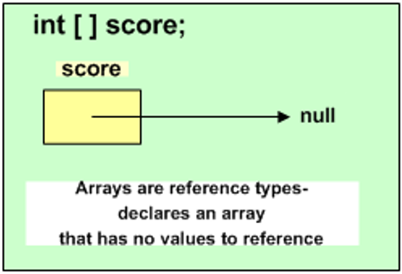
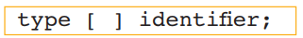
Array Declaration
Array Basics
Array identifier, name, references first element
Contains address where score[0] is located
First index for all arrays is 0
Last element of all arrays is always referenced by an index with a value of the length of the array minus one
Can declare an array without instantiating it
The general form of the declaration is:

Slide 9
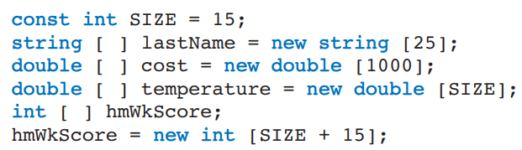
Array Declaration
Array Basics
If you declare array with no values to reference, 2nd step required – dimension the array
General form of the second step is:

Slide 10
Array Initializers
Array Basics
Compile-time initialization
General form of initialization follows:
Values are separated by commas
Values must be assignment compatible to the element type
Implicit conversion from int to double
Declare and initialize elements in one step
Array length determined by number of initialization values placed inside curly braces

Slide 11
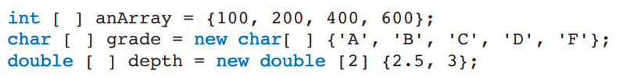
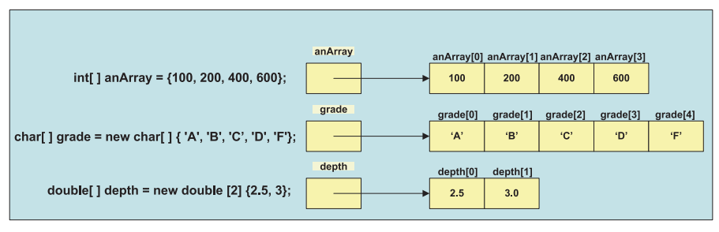
Array Initializers
Array Basics

Slide 12
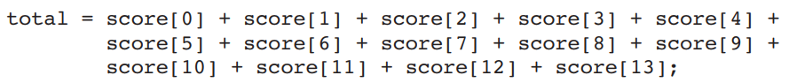
Array Access
Array Basics
Specify which element to access by suffixing the identifier with an index enclosed in square brackets
Length – special properties of Array class
Last valid index is always the length of the array minus one

Slide 13
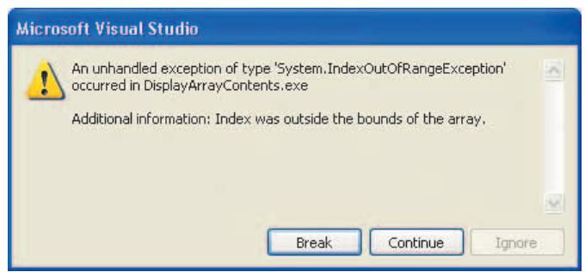
Array Access
Array Basics
If you create an array to hold 14 elements and include the following assignment statement:
a message similar to that shown below is generated, which indicates that the index was outside the boundaries of the array.

Slide 14
Sentinel-Controlled Access
Array Basics
What if you do not know the number of elements you need to store?
Could ask user to count the number of entries and use that for the size when you allocate the array
Another approach: create the array large enough to hold any number of entries
Tell users to enter a predetermined sentinel value after they enter the last value
Sentinel value
Extreme or dummy value

Slide 15
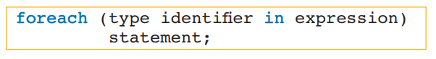
Using foreach with Arrays
Array Basics
Used to iterate through an array
Read-only access
General format
Identifier is the iteration variable
Expression is the array
Type should match the array type

Slide 16
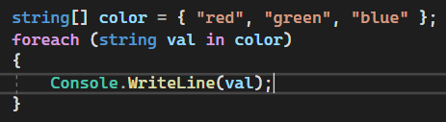
Using foreach with Arrays
Array Basics
Iteration variable, val represents a different array element with each loop iteration
No need to increment a counter (for an index)
Displays red, blue, and green on separate lines

Slide 17
Array Class
Array Basics
Base array class
All languages that target Common Language Runtime
More power is available with minimal programming

Slide 18
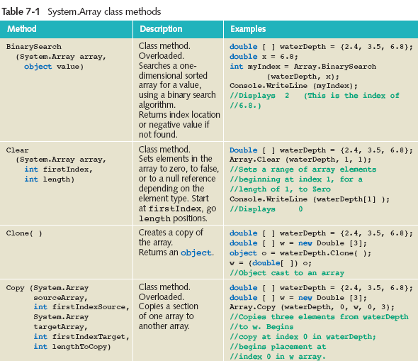
Array Class
Array Basics

Slide 19
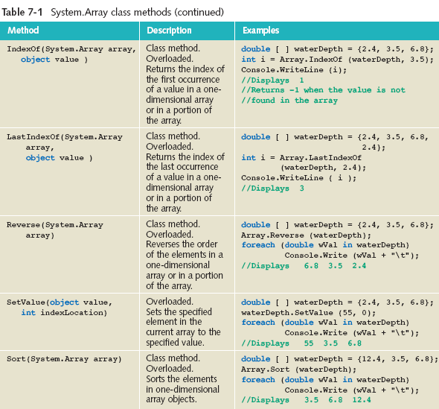
Array Class
Array Basics

Slide 20
Arrays as Method Parameters
Array Basics
Can send arrays as arguments to methods
Heading for method that includes array as a parameter
modifiers returnType identifier (type [ ] arrayIdentifier...)
Open and closed square brackets are required
Length or size of the array is not included
Example
void DisplayArrayContents (double [ ] anArray)

Slide 21
Pass by Reference
Array Basics
Arrays are reference variables
No copy is made of the contents
Array identifier memory location does not contain a value, but rather an address for the first element
Actual call to the method sends the address
Call does not include the array size
Call does not include the square brackets
Example
DisplayArrayContents (waterDepth);

Slide 22
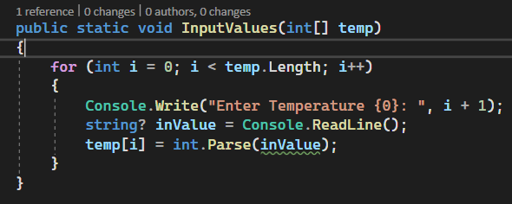
Input Values into an Array
Array Basics

Slide 23
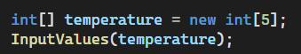
Input Values into an Array
Array Basics
To call InputValues(int [ ] temp) method

Slide 24
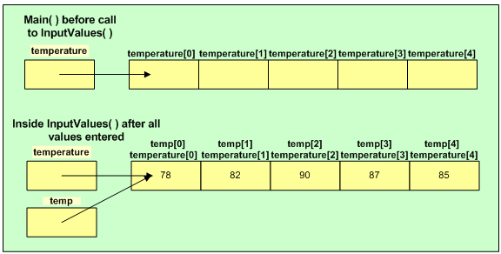
Input Values into an Array
Array Basics

Slide 25
Parameter Array
Array Basics
Keyword params used
Appears in formal parameter list (heading to the method)
Must be last parameter listed in the method heading
By including it, the method may be called one time with a single value
It makes the method very flexible.
It is useful when we don't know the number of arguments prior
Indicates number of arguments to the method that may vary
Another call to the same method could send 10 or 100 values or an array of values.
A variable number of arguments are accepted when params is included.

Slide 26
Demo

Slide 27



Questions?

Slide 28
Thank you

